Slide 1



DT – F16 Ram Sports Truck End Cap (SPAT) Development – Mopar
BY JINRONG

Slide 2
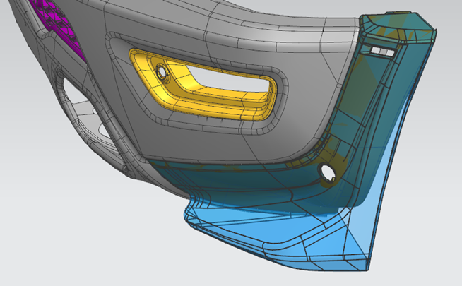
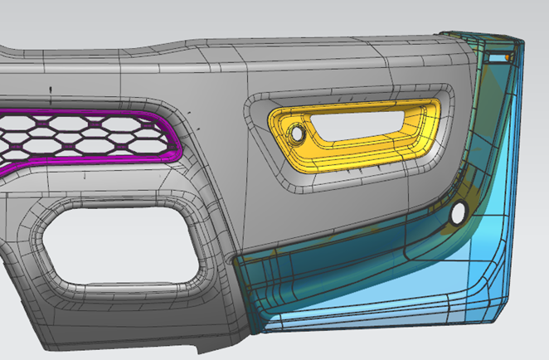
PRODUCT DEFINITION AND SCOPE OF DESIGN & SUPPLY
Retail service part definition
ITEM | DETAILS
Part Name | Spat Kit Right & Left - Primed finish, ready for paint.
New Part Number | 82219733AA
Vehicle & MYI-MYO | DT Sports Truck with front Bumper (Sales Code MCE) Stage 1 (5.7L) & Stage 2A (6.4L) base MY 2027-2029
Vehicle Application | Appearance & Performance
Installation Location | Front Bumper, right and left ends. At dealership – post sale
Material Grade & Color Code & Finish type & Texture & Color tolerance | Spat: MS.50041 TPO (previously MS-DC-256) Type: C. CPN 4981. Bracket Support: MS.50041 LBI's Hifax TYC 1168P CPN 4998 Sensor Bracket: MS.50041 LBI's Hifax TYC 1168P CPN 4981
Annual Volume | 1,020
Spat (light blue color)

Slide 3
PRODUCT DEFINITION AND SCOPE OF DESIGN & SUPPLY
Custom shop parts definition
ITEM | DETAILS
Part Name | Spat Kit Right & Left – Painted, Body Color
New Part Number TOTAL = 3,060
Vehicle & MYI-MYO | DT Sports Truck with front Bumper (Sales Code MCE) Stage 1 (5.7L) & Stage 2A (6.4L) base MY 2027-2029
Vehicle Application | Appearance & Performance
Installation Location | Front Bumper, right and left ends. Part installed at UTM Custom Shop, Saltillo Mexico
Material, Color, finish | Same as 82219733AA but painted body color as per above
PN | Description | Annual volume
68785495AA | ZR6 - Molten Red Pearl Coat | 520
68785506AA | ZG9 - Serrano Green Metallic | 367
68785507AA | KXJ - Diamond Black Crystal | 704
68785508AA | PDN - Ceramic Grey Clear Coat | 581
68785509AA | GW7 - Bright White Clear Coat | 643
68785510AA | EYB - Detonator Yellow | 245
Spat (light blue color)

Slide 4
Scope of Work
The scope of work will be design, development, manufacture, PPAP and supply of the parts.
The expectation is to deliver parts to:
Retail: 82219733AA (in prime) individually packaged to Mopar Depot.
Custom Shop: Six part numbers, in body color, to Utilimaster custom shop in Saltillo Mexico
The intent is to use same attachment strategy and the existing hardware herever possible from the current existing similar production parts.
Jinrong will provide direct buy letters to purchase the existing or any current production parts from the existing production suppliers.
The build objectives for the Gaps and finish will be same as the similar current production parts for this vehicle.
The A surface CAD data will be provided after the award of business and supplier will be responsible for development of B-surface and attachment points.
The selected supplier will be responsible for creation of CAD for the new part and 2D drawings.
A tech review can be requested if there are any questions or concerns prior to submission of quotes.
All component level testing will be supplier responsibility, and the system and vehicle level testing will be carried out by the Jinrong or Supplier.
Performance/test requirements are available in the DVP&R attached with the SP.
The chosen supplier will be responsible for supply of parts for the marketing and testing. Protect for 3 set of parts.
The DVP&R states the standard requirements for new parts, no testing will be required for the directed buy production components. Effort should be made to use products which are proven, and test data is available to minimize the new testing wherever possible.

Slide 5
PART SUMMARY
OTHER
Final data must be submitted to Mopar and reviewed/approved prior to kick-off.
Supplier is design responsible and must provide CAD models for this PN.
Test costs must be submitted and itemized based on DVP, as well as additional ED&D (Engineering Design & Development) costs for engineering or design services
GD&T documentation and quote assumptions must follow guidelines defined in PS-9611 Geometric Dimensioning and Tolerancing Practice.
Supplier is responsible for the development of installation instructions.
Supplier is Responsible for Development of I-Sheet. Kit will contain QR code sheet provided by Jinrong, which links to the I-sheet document electronically.
VALIDATION:
Must satisfy requirements detailed in the DVP&R and the following Jinrong standards.
If supplier intends to use surrogate data for any of the DVP line items, it must be noted at time of quote submittal, reviewed with engineering, and should not be more than 3 years old, unless a deviation is provided by Mopar Product Development.
Part Volume - Sample and SoP:
Engineering Fit-ups: 3 samples (primed)
Testing/Validation as required per attached DVP
Supplier Quality: 3 kits - Marketing: 1
PER samples: 2 body colors

Slide 6
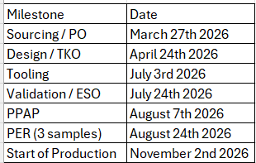
PART SUMMARY
Timing detail:
Supplier must provide a detailed timeline and should capture specifics on all the activities related to this development, including but not limited to PO's, Design, Testing, Tooling, DV testing, system level PV testing, Packaging, PPAP,
Logistics, and Shipment to Mopar warehouse Timeline should capture responsible person/group for each task and should capture dependencies.
Timing should also include any contingencies for additional factors (holidays, shutdowns, sea shipments, second development etc.) to meet the vehicle timing requirements listed above
Timeline sent should be accompanied with a document listing all assumptions that won't into defining the durations for the tasks documented. Any anticipated risks to the proposed timeline should be highlighted along with proposals to address the same
A detailed process depicting location and responsible source for raw materials, tool design, tool build, part manufacture, part development, part packaging, and where shipped from should accompany the timeline.
Timing and sample requirements

Slide 7
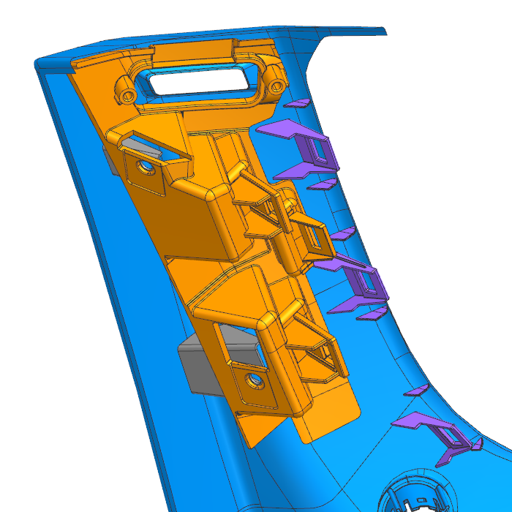
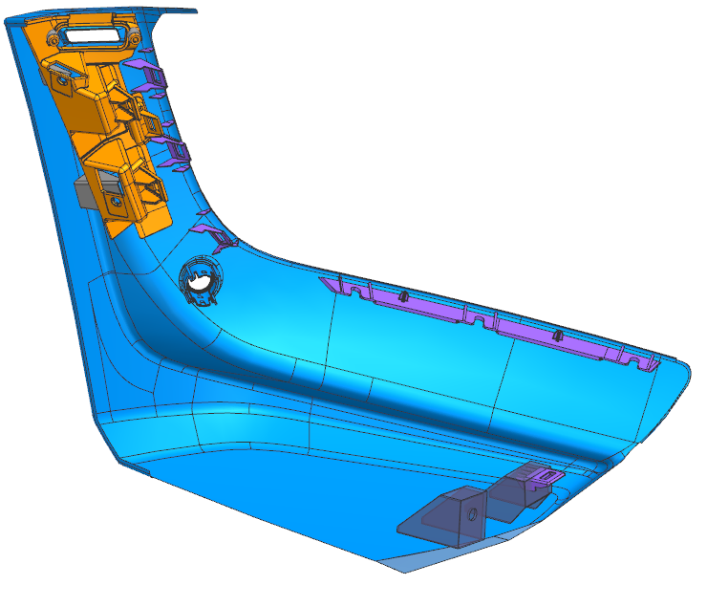
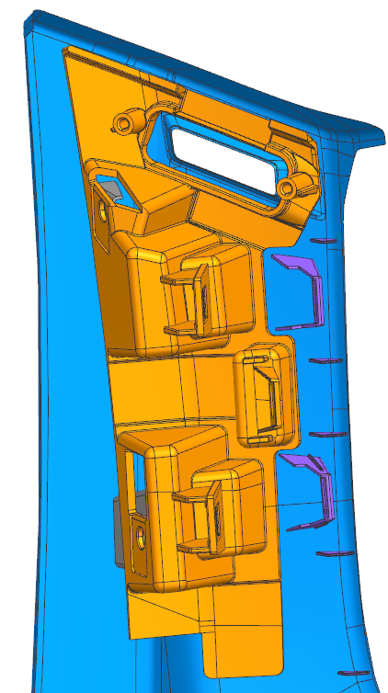
Bracket
Spat
Left Side Part Shown

Slide 8
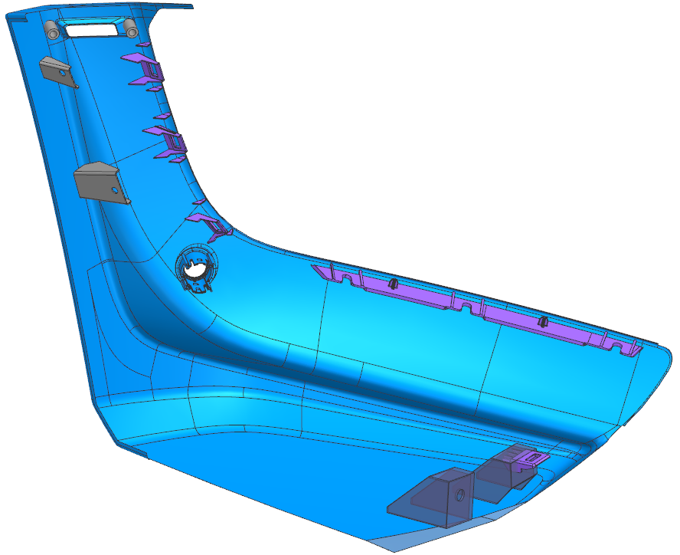
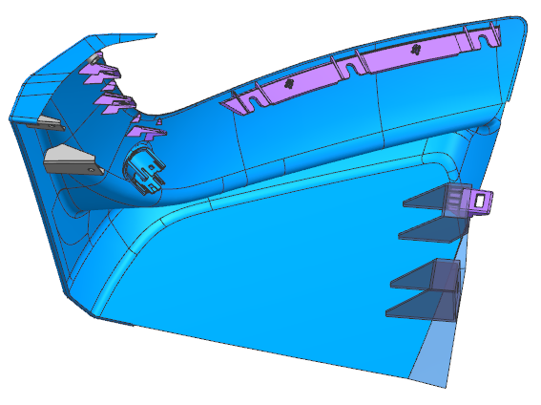
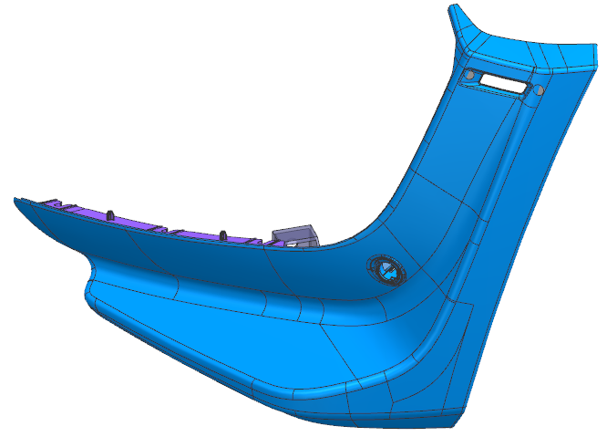
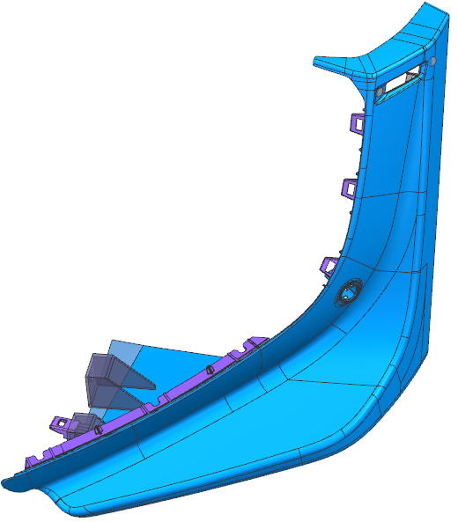
Mopar 27DT Front Aero Spat Presource Info 05152026
Left Side Part Shown

Slide 9
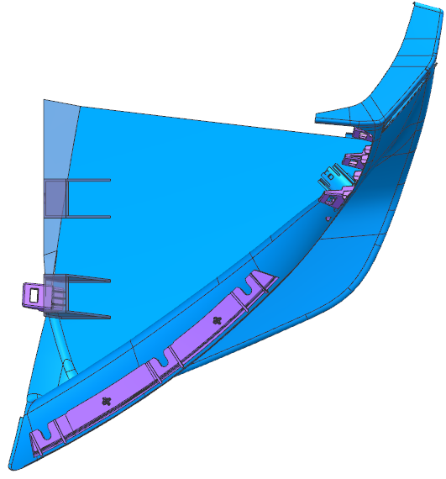
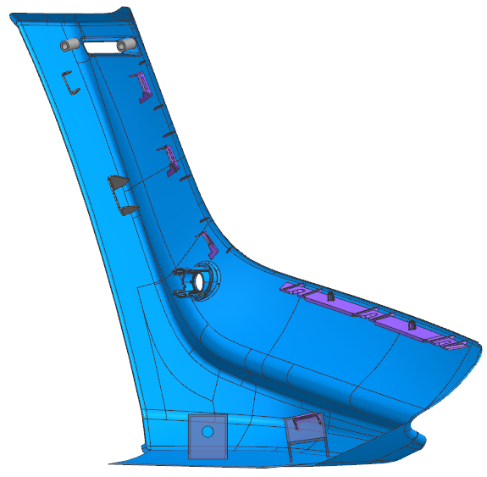
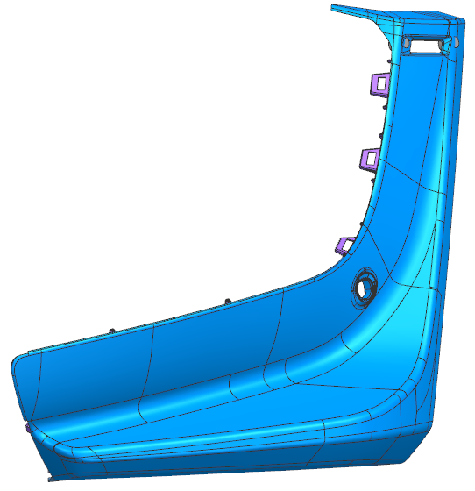
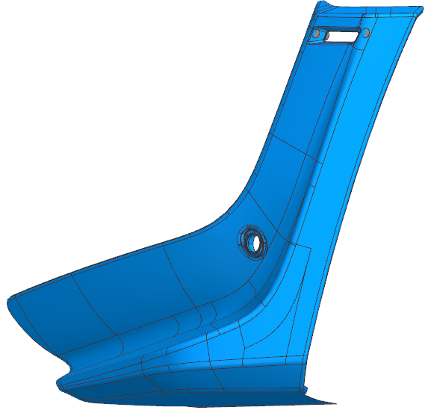
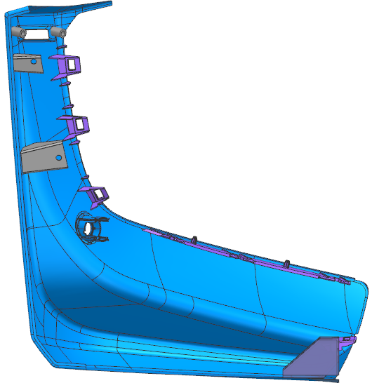
Left Side Part Shown
Plan View
410
425
400
Left Side View
Rear View
Right Side View
Front View

Slide 10
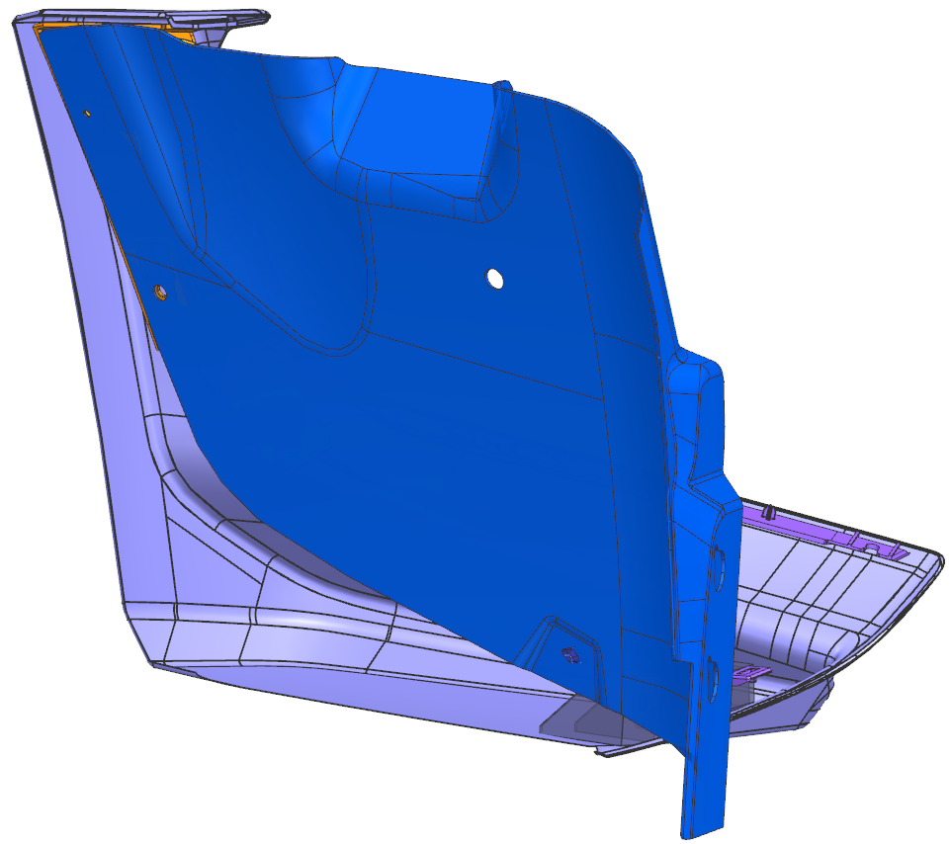
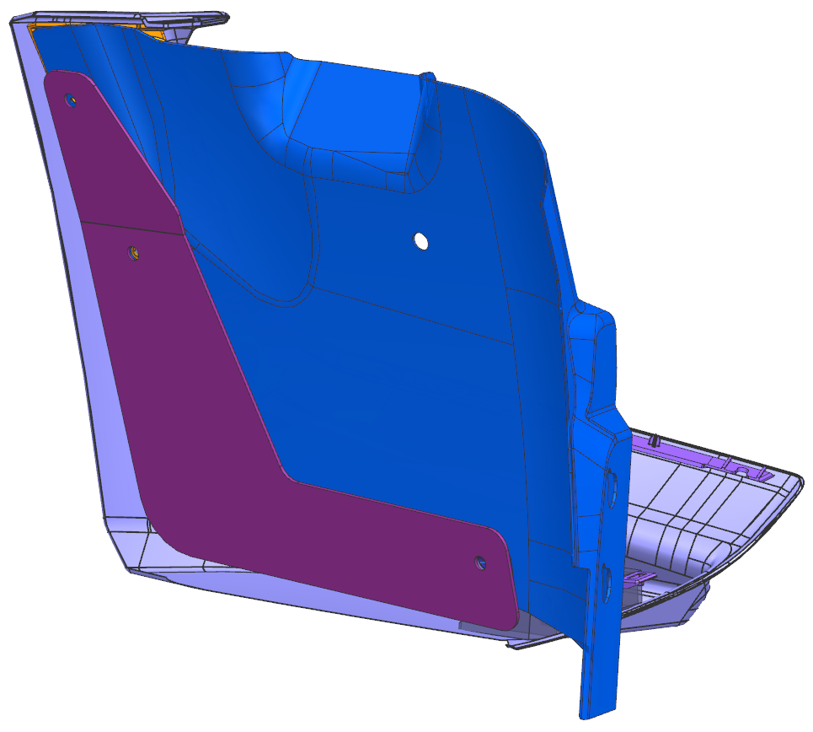
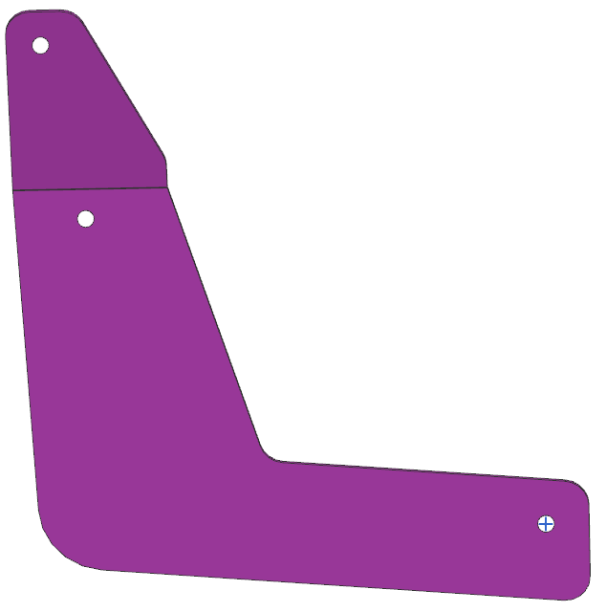
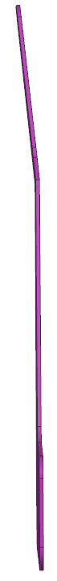
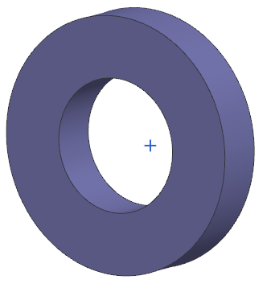
Close Out
Production splash shield
(reference only)
4.2 mm ID
15 to 25 mm OD
5 mm thick
370
Spacer
350

Slide 11
Fasteners
PN | Description | Material | QTY
06509800AA | M-4.8 U-Clip, End Cap to wheel liner | PS-11036 | 4

